Slide 1
GAS BOOKING SYSTEM
KN MADUSHAN
JL/22/ICT5/1/0032

Slide 2
Introduction
This application is real estate management through which individual agents or buyer can maintain their property document keeping and managing property registration and also access its information and manage all the adding, updating, deleting the as and some of its tasks. The Admin user can inform their agents regarding property and update the information regarding property and cancellation of property or changing buyer choice.

Slide 3
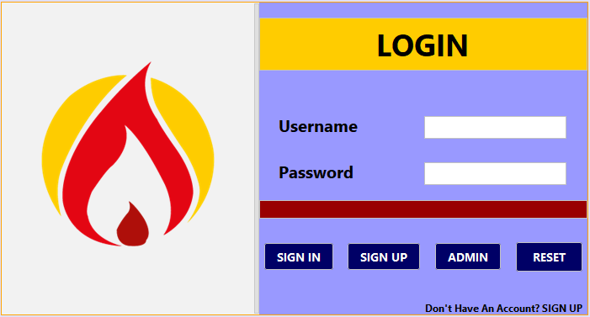

Slide 4
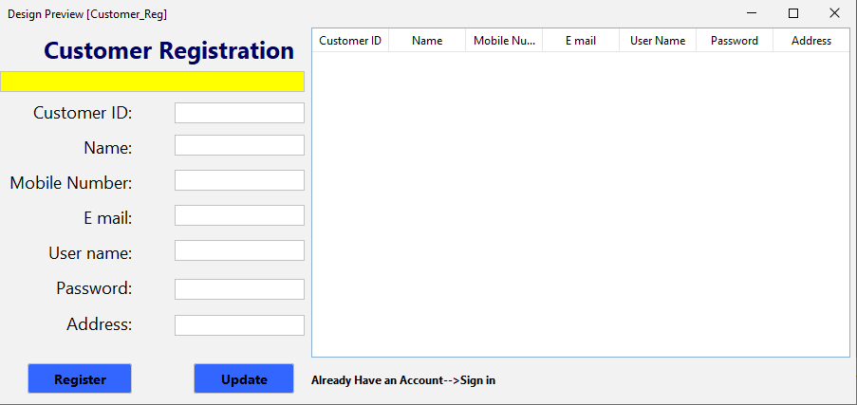

Slide 5
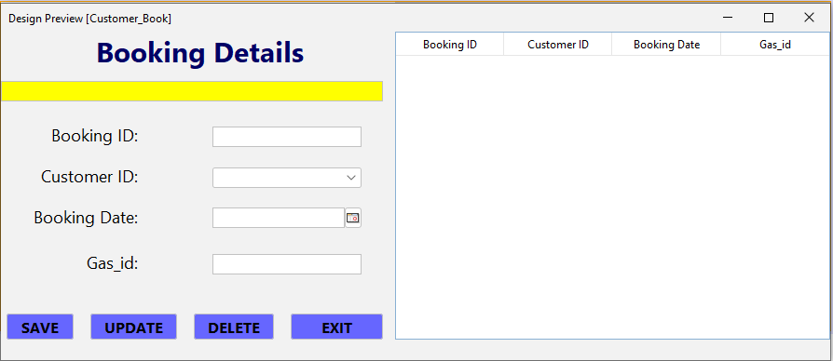

Slide 6
THANK YOU

